Slide 1

Project 4:
Rachel weber

Slide 2
Aims and Hypotheses
Aim 1
Hypothesis a. Higher baseline levels of cytokines and chemokines is associated with greater declines in episodic memory and decreased cortical thickness
Hypothesis b. Greater increases in cytokines and chemokines is associated with greater declines in episodic memory and decreased cortical thickness
Aim 2
Hypothesis: Presence of Amyloid Deposition and elevated peripheral inflammatory markers is the strongest predictor of memory decline and decline in AD-signature cortical thickness
Aim 3
Hypothesis a. Levels of cytokines and chemokines from CNS-derived exosomes will be higher in aMCI relative to HC subjects.
Hypothesis b. High levels of inflammatory markers from CNS-derived exosomes and increases in these levels better predicts memory decline and decreases in AD-signature on neuroimaging relative to total exosomes.

Slide 3
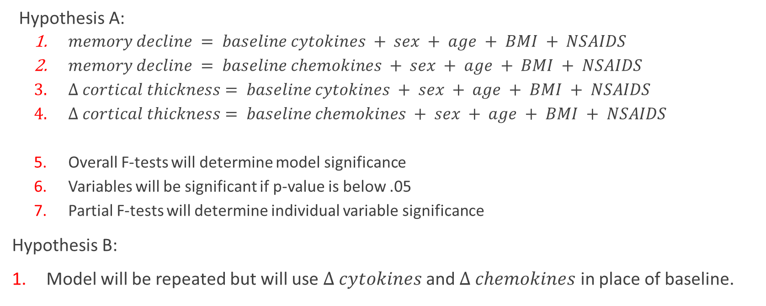
Aim 1—Analysis Plan
Hypothesis A:
$memory decline = baseline cytokines + sex + age + BMI + NSAIDS$
$memory decline = baseline chemokines + sex + age + BMI + NSAIDS$
$Δ cortical thickness= baseline cytokines + sex + age + BMI + NSAIDS$
$Δ cortical thickness= baseline chemokines + sex + age + BMI + NSAIDS$
Overall F-tests will determine model significance
Variables will be significant if p-value is below .05
Partial F-tests will determine individual variable significance
Hypothesis B:
Model will be repeated but will use $Δ cytokines$and $Δ chemokines$ in place of baseline.

Slide 4
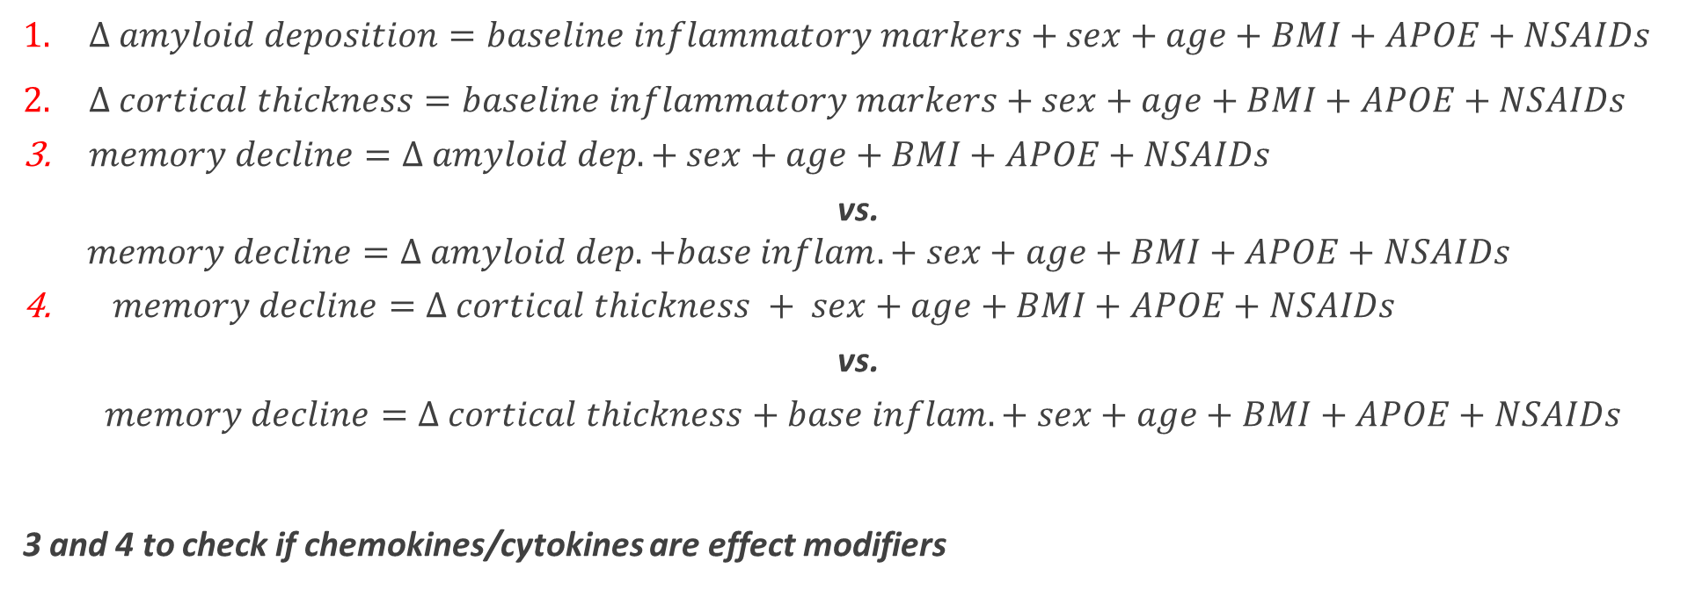
Aim 2—Analysis Plan
$Δ amyloid deposition=baseline inflammatory markers+sex+age+BMI+APOE+NSAIDs$
$Δ cortical thickness=baseline inflammatory markers+sex+age+BMI+APOE+NSAIDs$
$memory decline=Δ amyloid dep. + sex+age+BMI+APOE+NSAIDs$
vs.
$$memory decline=Δ amyloid dep. +base inflam. + sex+age+BMI+APOE+NSAIDs$$
$memory decline=Δ cortical thickness + sex+age+BMI+APOE+NSAIDs$
vs.
$memory decline=Δ cortical thickness+base inflam. + sex+age+BMI+APOE+NSAIDs$
3 and 4 to check if chemokines/cytokines are effect modifiers

Slide 5
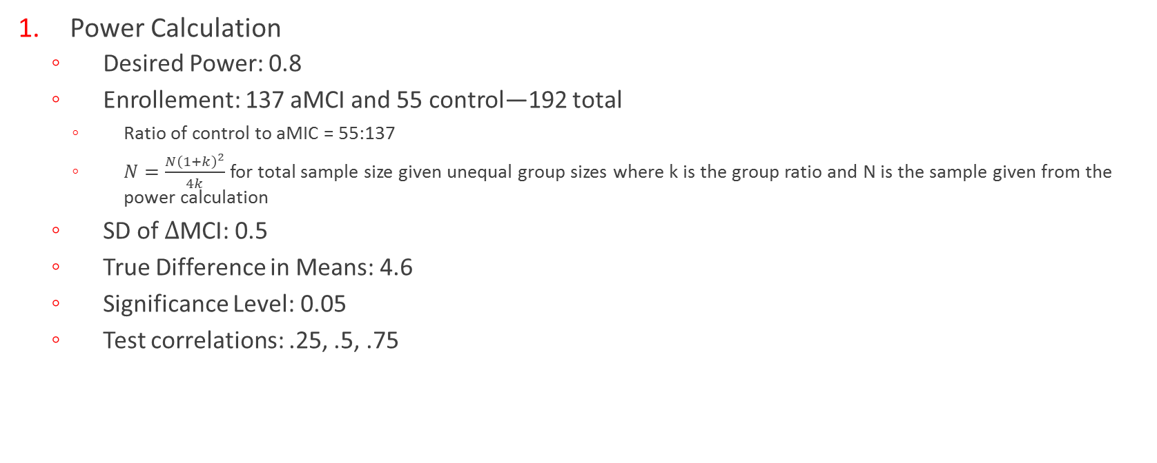
Aim 3—Sample Size Calculation
Power Calculation
Desired Power: 0.8
Enrollement: 137 aMCI and 55 control—192 total
Ratio of control to aMIC = 55:137
$N=\frac{N{\left(1+k\right)}^{2}}{4k}$ for total sample size given unequal group sizes where k is the group ratio and N is the sample given from the power calculation
SD of $Δ$MCI: 0.5
True Difference in Means: 4.6
Significance Level: 0.05
Test correlations: .25, .5, .75
Whitley E, Ball J. Statistics review 4: sample size calculations. Crit Care. 2002;6(4):335-41.

Slide 6
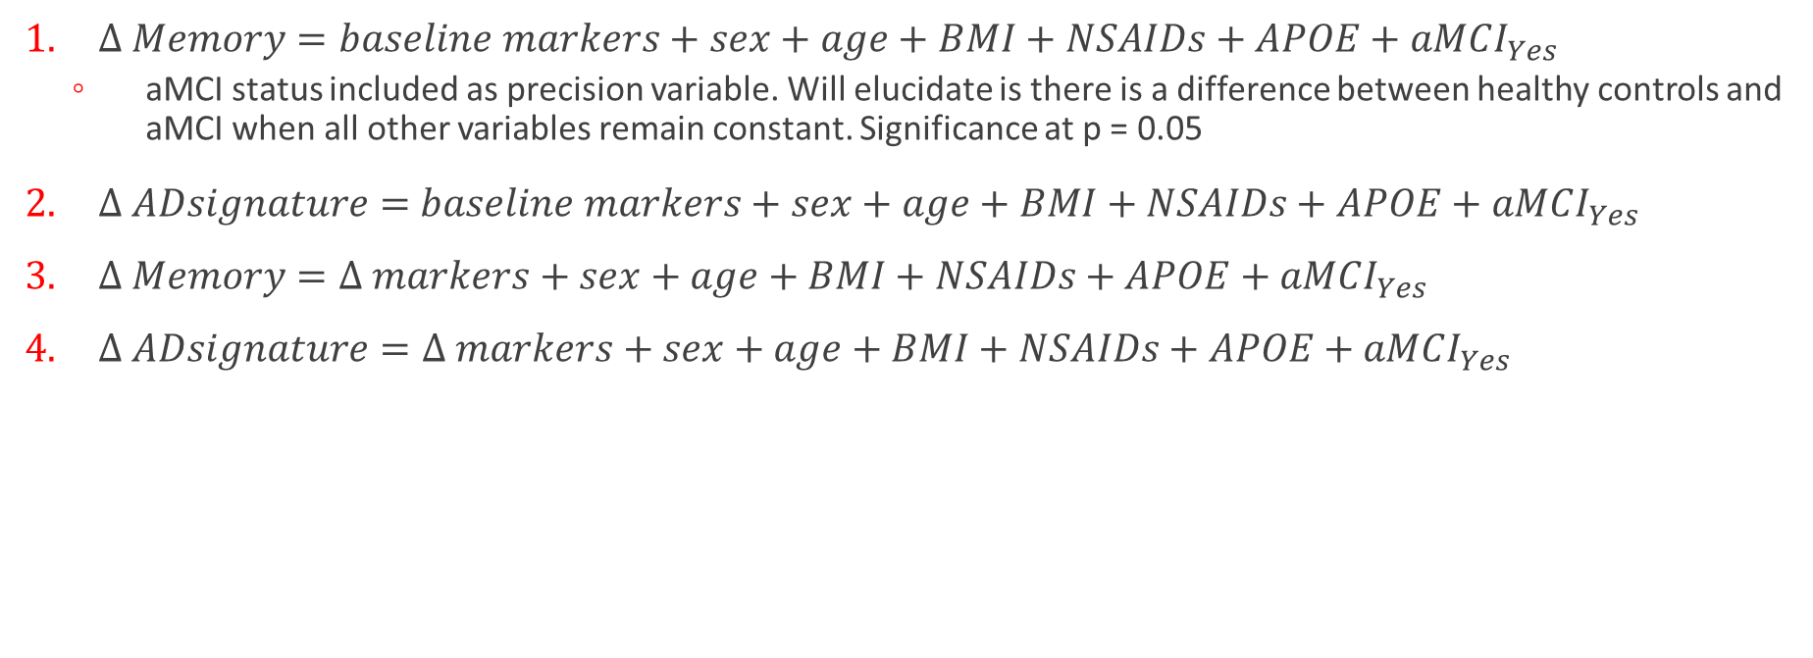
Aim 3—Analysis Plan
$Δ Memory=baseline markers+sex+age+BMI+NSAIDs+APOE+aMCI_{Yes}$
aMCI status included as precision variable. Will elucidate is there is a difference between healthy controls and aMCI when all other variables remain constant. Significance at p = 0.05
$Δ ADsignature=$ $baseline markers+sex+age+BMI+NSAIDs+APOE+aMCI_{Yes}$
$Δ Memory=Δ markers+sex+age+BMI+NSAIDs+APOE+aMCI_{Yes}$
$Δ ADsignature=Δ markers+sex+age+BMI+NSAIDs+APOE+aMCI_{Yes}$

